Slide 1
Entering the world of Serious Games with Python
By Harshinee Sriram
www.harshineesriram.com

Slide 2
What will you learn today?
What are serious and therapeutic games?
Stages involved in serious game development
Current examples of therapeutic games
What is Pygame?
How do you make a simple therapeutic game with Pygame?
What does the future hold?

Slide 3
What are serious and therapeutic games?

Slide 4
What are serious games?
Serve a purpose beyond entertainment
Combined with a real life objective
Influencing the mindset/thinking of the player
Usually divided into
Games for education
Games for health

Slide 5
What are serious games?
Taxonomy of Games for Health (two parameter model):
Function (preventive, therapeutic, assessment, educational, informatics)
Public (personal, professional practice, research, public health)
Taxonomy of Games for Health (four parameter model):
Gameplay
Function
Purpose
Public

Slide 6
What are therapeutic games?
Manages a mental health condition
Alleviates and potentially treats a disease or condition
Recovery technique:
Medical
Psychiatric
Psychological
Can be directly or indirectly therapeutic

Slide 7
Stages involved in serious game development

Slide 8
Serious games for Mental Health Treatment
Informative Game Playing
Therapeutic Game Designing
Therapeutic Game Playing

Slide 9
Informative Game Playing
Game designer creates the game
Player learns about the mental illness via the game
Increase in knowledge and possibly have increased empathy
Increased empathy + decreased stigma = better treatment options

Slide 10
Therapeutic Game Designing
Game designer is suffering from mental illness
Creates a game for their own personal treatment
Player experiences creation of the game designer
Therapeutic catharsis or sense of closure

Slide 11
Therapeutic Game Playing
Game designer researches treatment methods
Creates a game that incorporates some treatment methods
Player navigates the world of the game
Consciously/Unconsciously the player receives treatment

Slide 12
Current examples of therapeutic games

Slide 13
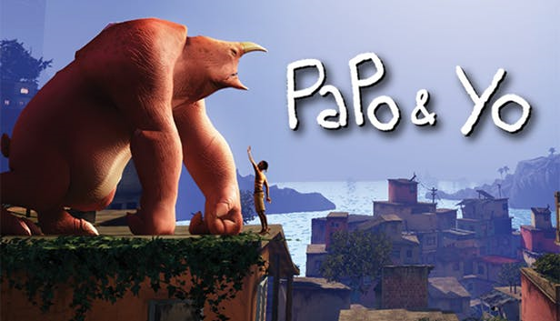
Revolves around a young boy (Quico) trying to find a cure for his best friend who has an addiction to frogs
When his best friend eats frogs, he transforms into a violent foe, and the Quico is forced to run and hide.
The end of the game reveals that by himself Quico is not capable of fixing the Monster's addiction.
The game designer grew up with an alcoholic father and the game manifests his experiences

Slide 14

Shows the experience of having a child diagnosed with terminal cancer.
Point-and-click format, and tells the story of the parent’s battle with a dragon, cancer.
Some scenes are in hospital settings, embodies the parent’s hopelessness
Living art form, a mean of coping mechanism

Slide 15

A video game and therapy tool for children with autism and developmental disabilities that focuses on teaching person-to-person communication.
Players search for lost toys and explore vibrant, 3D, storybook levels based on real-world environments where children typically need behavioral improvements.
Communication with people is essential.

Slide 16
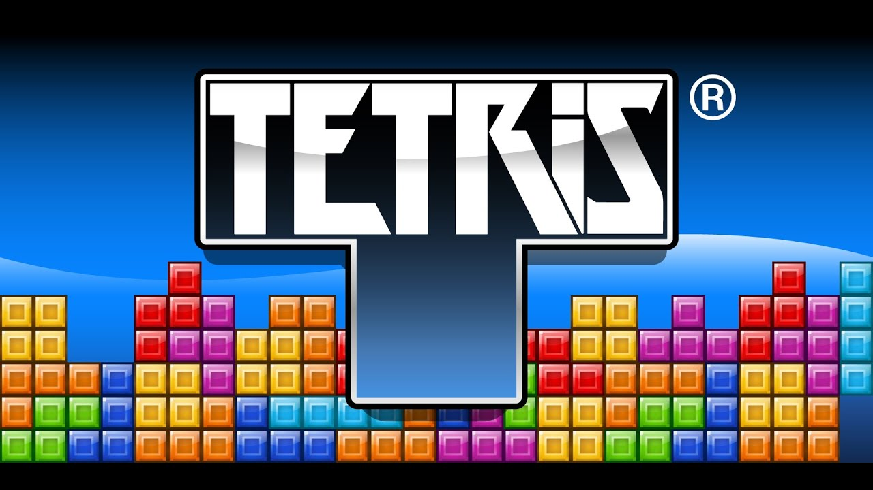
Capable of reducing flashbacks for people with Post-Traumatic Stress Disorder (PTSD)
Can disrupt the formation of involuntary mental image flashbacks
Proven to calm down people undergoing anxiety-inducing events

Slide 17
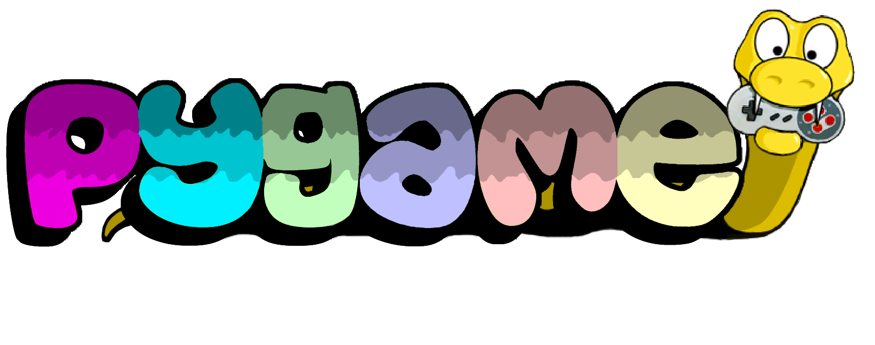
What is

Slide 18
What is Pygame?
Cross-platform set of Python modules designed for writing video games
Computer graphics and sound libraries for Python programming language
Easy to learn and use

Slide 19
How do you make a simple therapeutic game with Pygame?

Slide 20
Importing important libraries and initial configuration
from random import randrange as rand
import pygame, sys
config = {
'cell_size': 20,
'cols': 8,
'rows': 16,
'delay': 750,
'maxfps': 30
}
colors = [
(0, 0, 0 ),
(255, 0, 0 ),
(0, 150, 0 ),
(0, 0, 255),
(255, 120, 0 ),
(255, 255, 0 ),
(180, 0, 255),
(0, 220, 220)
]

Slide 21
Define tetris shapes
tetris_shapes = [
[[1, 1, 1],
[0, 1, 0]],
[[0, 2, 2],
[2, 2, 0]],
[[3, 3, 0],
[0, 3, 3]],
[[4, 0, 0],
[4, 4, 4]],
[[0, 0, 5],
[5, 5, 5]],
[[6, 6, 6, 6]],
[[7, 7],
[7, 7]]
]

Slide 22
Rotation and remove board functions
def rotate_clockwise(shape):
return [ [ shape[y][x]
for y in range(len(shape)) ]
for x in range(len(shape[0]) - 1, -1, -1) ]
def remove_row(board, row):
del board[row]
return [[0 for i in range(config['cols'])]] + board

Slide 23
Check collision function
def check_collision(board, shape, offset):
off_x, off_y = offset
for cy, row in enumerate(shape):
for cx, cell in enumerate(row):
try:
if cell and board[ cy + off_y ][ cx + off_x]:
return True
except IndexError:
return True
return False

Slide 24
Join matrices and new board functions
def join_matrixes(mat1, mat2, mat2_off):
off_x, off_y = mat2_off
for cy, row in enumerate(mat2):
for cx, val in enumerate(row):
mat1[cy+off_y-1 ][cx+off_x] += val
return mat1
def new_board():
board = [ [ 0 for x in range(config['cols']) ]
for y in range(config['rows']) ]
board += [[ 1 for x in range(config['cols'])]]
return board

Slide 25
Class definition
class TetrisApp(object):
def __init__(self): #FUNCTION 1
pygame.init()
pygame.key.set_repeat(250,25)
self.width = config['cell_size']*config['cols']
self.height = config['cell_size']*config['rows']
self.screen = pygame.display.set_mode((self.width, self.height))
pygame.event.set_blocked(pygame.MOUSEMOTION)
self.init_game()

Slide 26
def new_stone(self): #FUNCTION 2
self.stone = tetris_shapes[rand(len(tetris_shapes))]
self.stone_x = int(config['cols'] / 2 - len(self.stone[0])/2)
self.stone_y = 0
if check_collision(self.board,
self.stone,
(self.stone_x, self.stone_y)):
self.gameover = True
def init_game(self): #FUNCTION 3
self.board = new_board()
self.new_stone()

Slide 27
def center_msg(self, msg): #FUNCTION 4
for i, line in enumerate(msg.splitlines()):
msg_image = pygame.font.Font(
pygame.font.get_default_font(), 12).render(
line, False, (255,255,255), (0,0,0))
msgim_center_x, msgim_center_y = msg_image.get_size()
msgim_center_x //= 2
msgim_center_y //= 2
self.screen.blit(msg_image, (
self.width // 2-msgim_center_x,
self.height // 2-msgim_center_y+i*22))

Slide 28
def draw_matrix(self, matrix, offset): #FUNCTION 5
off_x, off_y = offset
for y, row in enumerate(matrix):
for x, val in enumerate(row):
if val:
pygame.draw.rect(
self.screen,
colors[val],
pygame.Rect(
(off_x+x) *
config['cell_size'],
(off_y+y) *
config['cell_size'],
config['cell_size'],
config['cell_size']),0)

Slide 29
def move(self, delta_x): #FUNCTION 6
if not self.gameover and not self.paused:
new_x = self.stone_x + delta_x
if new_x < 0:
new_x = 0
if new_x > config['cols'] - len(self.stone[0]):
new_x = config['cols'] - len(self.stone[0])
if not check_collision(self.board,
self.stone,
(new_x, self.stone_y)):
self.stone_x = new_x

Slide 30
def quit(self): #FUNCTION 7
self.center_msg("Exiting...")
pygame.display.update()
pygame.quit()
sys.exit()
def rotate_stone(self): #FUNCTION 8
if not self.gameover and not self.paused:
new_stone = rotate_clockwise(self.stone)
if not check_collision(self.board,
new_stone,
(self.stone_x, self.stone_y)):
self.stone = new_stone
def toggle_pause(self): #FUNCTION 9
self.paused = not self.paused

Slide 31
def drop(self): #FUNCTION 10
if not self.gameover and not self.paused:
self.stone_y += 1
if check_collision(self.board,
self.stone,
(self.stone_x, self.stone_y)):
self.board = join_matrixes(
self.board,
self.stone,
(self.stone_x, self.stone_y))
self.new_stone()
while True:
for i, row in enumerate(self.board[:-1]):
if 0 not in row:
self.board = remove_row(
self.board, i)
break
else:
break

Slide 32
def start_game(self): #FUNCTION 11
if self.gameover:
self.init_game()
self.gameover = False
def run(self): #FUNCTION 12
key_actions = {
'ESCAPE': self.quit,
'LEFT': lambda:self.move(-1),
'RIGHT': lambda:self.move(+1),
'DOWN': self.drop,
'UP': self.rotate_stone,
'p': self.toggle_pause,
'SPACE': self.start_game
}

Slide 33
self.gameover = False #FUNCTION 12 CONTINUED
self.paused = False
pygame.time.set_timer(pygame.USEREVENT+1, config['delay'])
dont_burn_my_cpu = pygame.time.Clock()
while 1:
self.screen.fill((0,0,0))
if self.gameover:
self.center_msg("""Game Over!
Press space to continue""")
else:
if self.paused:
self.center_msg("Paused")
else:
self.draw_matrix(self.board, (0,0))
self.draw_matrix(self.stone,
(self.stone_x,
self.stone_y))
pygame.display.update()

Slide 34
for event in pygame.event.get(): #FUNCTION 12 CONTINUED
if event.type == pygame.USEREVENT+1:
self.drop()
elif event.type == pygame.QUIT:
self.quit()
elif event.type == pygame.KEYDOWN:
for key in key_actions:
if event.key == eval("pygame.K_"
+key):
key_actions[key]()
dont_burn_my_cpu.tick(config['maxfps']) #END OF FUNCTION 12
if __name__ == '__main__':
App = TetrisApp()
App.run()

Slide 35
What does the future hold?

Slide 36
What does the future hold?
Emotion recognition capabilities
More accessibility
Developing games that adapt to the player’s personality and behavioral patterns
Untapped potential due to certain biases related to violent video games and video game addiction

